Slide 1
The IDEAL Reporting Guidelines for Reporting the Evaluation of
Surgical Innovation
Nicole Bilbro, Allison Hirst, Arsenio Paez, Peter McCulloch
For the IDEAL Collaboration
NB Maimonides Medical Center, Department of Surgery, Brooklyn, NY, US
AH & PMcC University of Oxford, Nuffield Department of Surgical Sciences, Oxford, UK
AP Nuffield Department of Primary Care Health Sciences, University of Oxford, UK; Northeastern University, Bouve College of Health Sciences, Boston, MA

Slide 2
Outline
What is IDEAL?
What are reporting guidelines?
Why are IDEAL reporting guidelines needed?
The consensus development process
The final reporting checklists
How can they help?

Slide 3
What is IDEAL?
Surgical research faces significant challenges, including blinding, equipoise, learning curves, technique standardization
Idea, Development, Exploration, Assessment, Long Term Study (IDEAL) Framework and Recommendations were introduced in 2009 to address these unique problems and improve the quality of surgical evidence
The IDEAL Framework has evolved over time and now includes a model for medical devices evaluation, IDEAL-D, and a modified framework for physical therapy and rehabilitation, IDEAL-Physio.

Slide 4
IDEAL Stages
Idea (First in Human) 1
Development 2a
Exploration 2b
Assessment 3
Long Term Study 4
Complete technical description
Explanation of patient selection
Registration of report
Prospective Cohort Study
Transparent Consecutive Reporting of Cases
Explanation of Changes in Technique, Indication
Prospective collaborative cohort study
Evaluation of learning curves
Definition of QC parameters
Estimation of power calculations
Early joint analysis leading to RCT
Definitive RCT
Removal of investigator bias from recruitment
Registry to detect late/rare events
Monitoring of indication and performance creep

Slide 5
What are Reporting Guidelines?
The EQUATOR Network defines a reporting guideline as “a simple, structured tool for health researchers to use while writing manuscripts to guide the authors in reporting a specific type of research”.
Provide a minimum list of information needed to ensure a manuscript can be understood and assessed by a reader, replicated by a researcher, used to make a clinical decision, and included in a systematic review.
There are now >400 checklists on the EQUATOR Network’s website, including 42 that are surgery related. Do we need more?

Slide 6
Why are IDEAL reporting guidelines needed in surgery?
While a multitude of surgery reporting guidelines exist, none adequately address all the stages of surgical innovation
The IDEAL reporting guidelines have a unique and specific focus on stepwise evaluation of surgical innovation through all stages of its development
Inaccuracy in reporting has been noted in studies attempting to follow the IDEAL recommendations and suggests a pressing need for IDEAL reporting guidelines

Slide 7
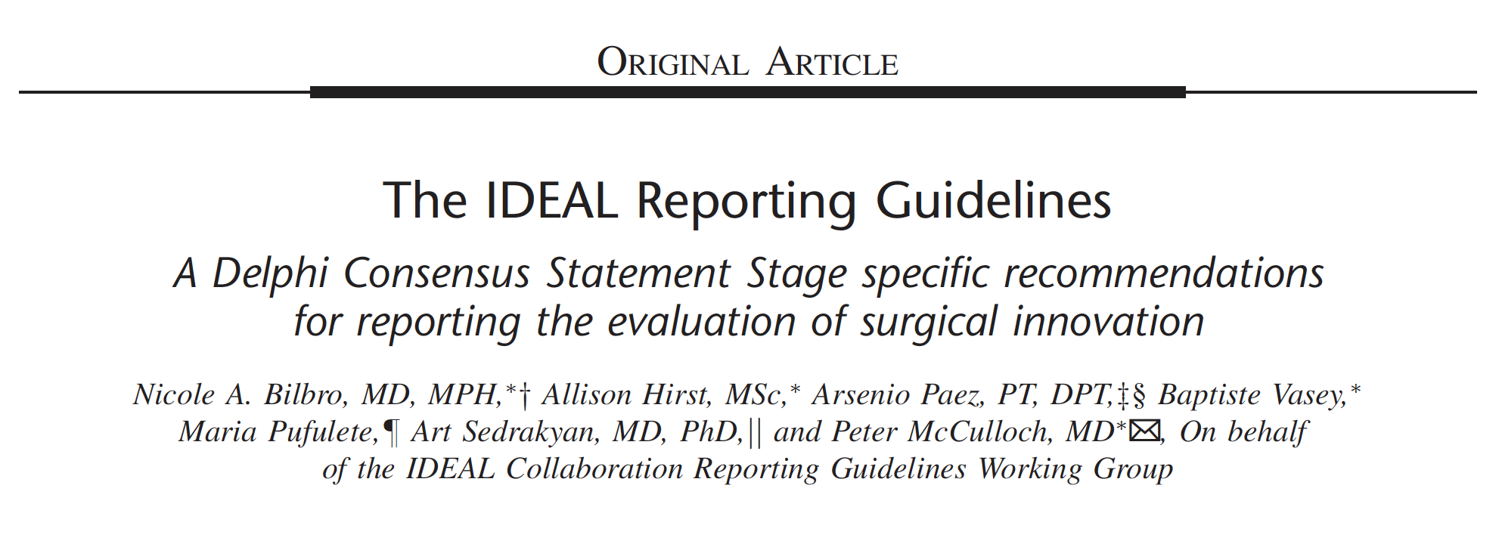

Slide 8
Delphi Guideline Development
Reporting Checklist drafted
2 rounds of checking and final expert consensus call
Further Evaluation
Are Reporting Guidelines needed for each Stage in IDEAL?
Results of use in real-world studies will be analysed and guidelines modified if necessary.
Yes
For all stages except 3
2 round Delphi process
Final Checklist
Further evaluation needed
Survey
(n=61)
70% for + <15% against = consensus for
(same for against)
Terminology Agreed
.

Slide 9
The Final Reporting Checklists

Slide 10
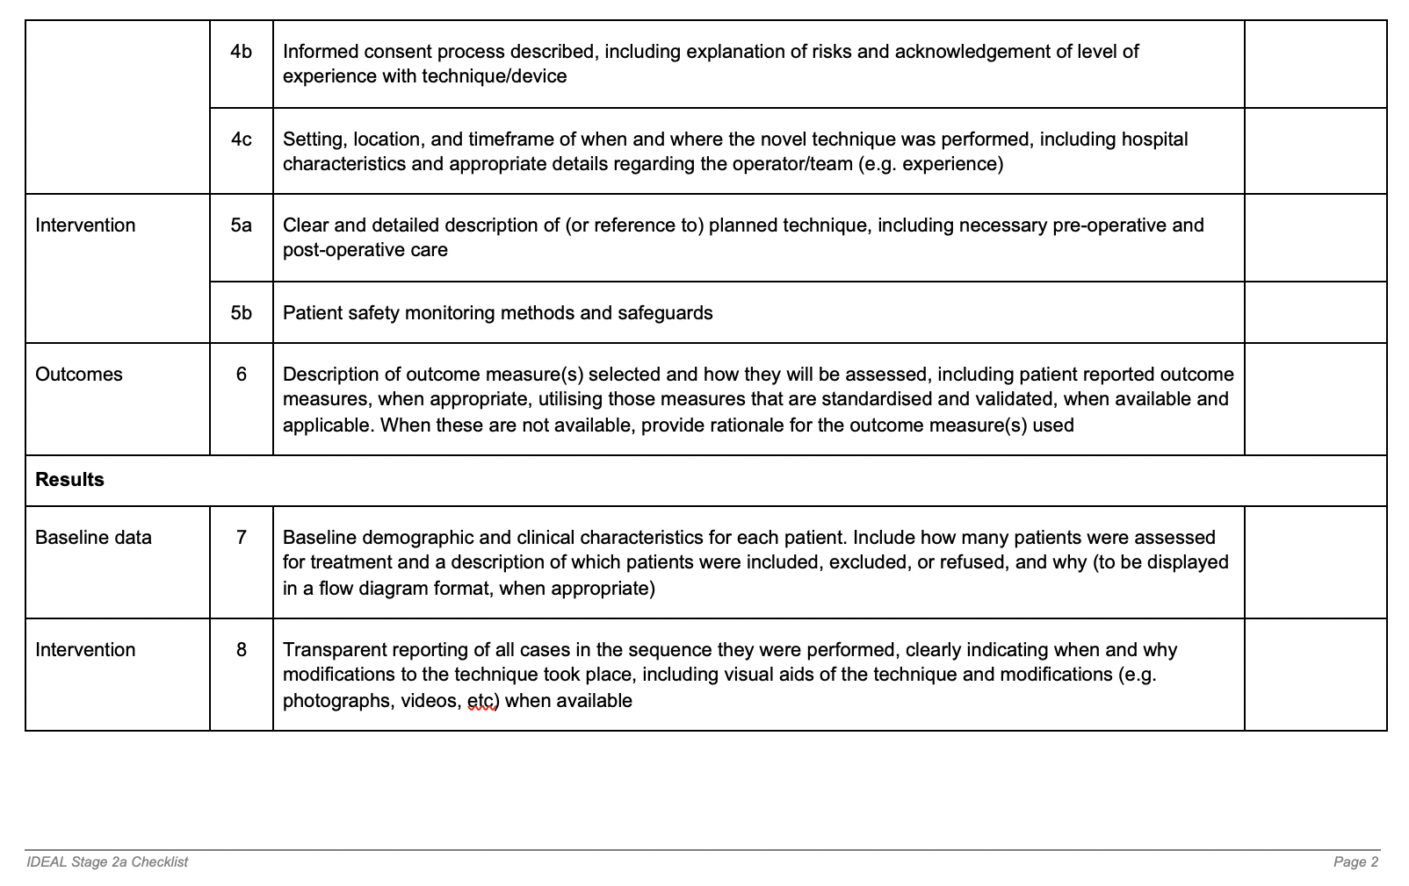

Slide 11
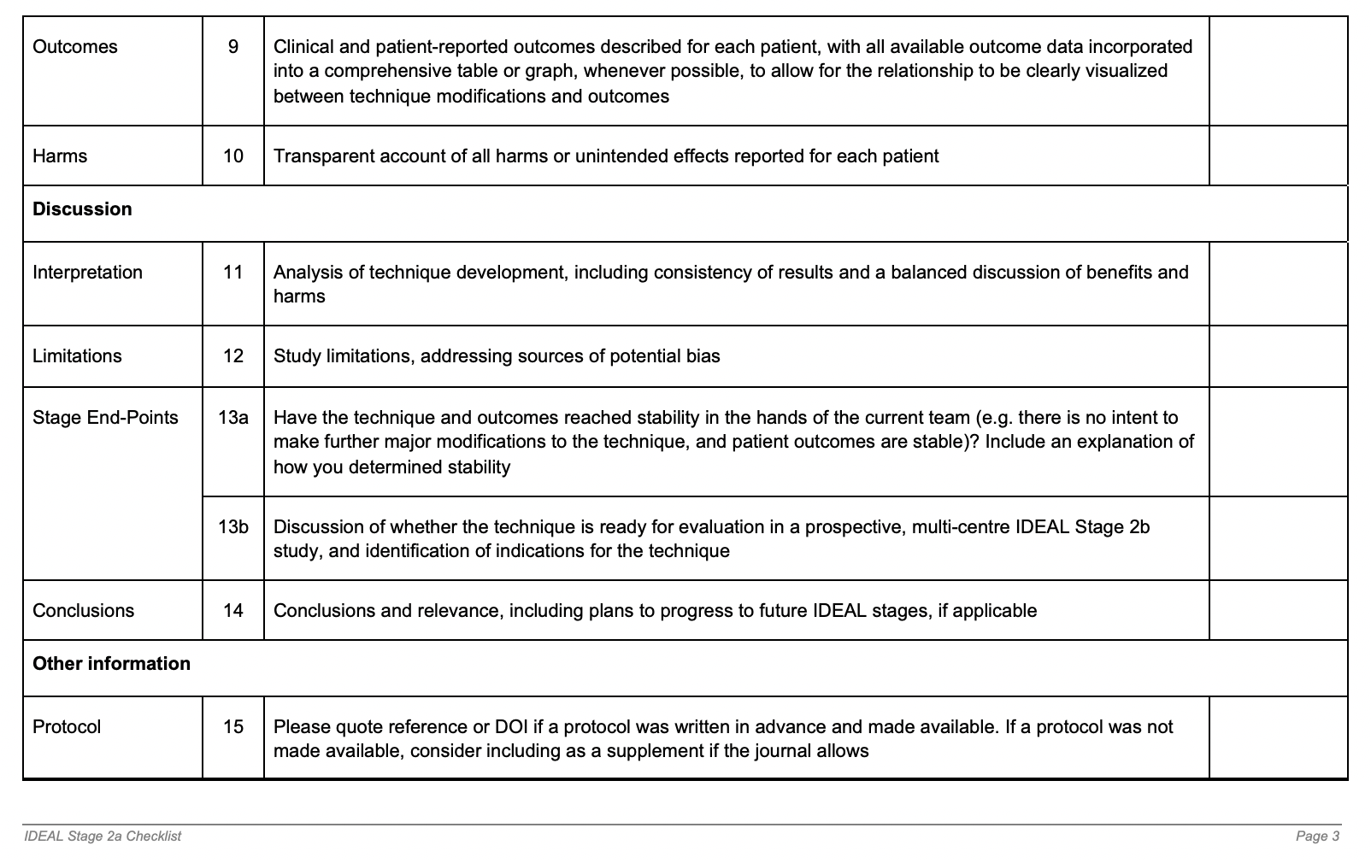

Slide 13
How can they help?
Improve the overall quality and transparency of surgical research reporting
Author’s compliance with IDEAL principles when designing studies and writing manuscripts
Assist journal editors and reviewers in verifying that authors are following the guidelines
But only if they are freely accessible, editable, widely disseminated and adopted

Slide 14
Thank you to:
IDEAL Working Group
Jane Blazeby, Maroeska Rovers, Christopher Pennell, Joel Horovitz, Angelos Kolias, Janet Martin, Tom Lewis, Riaz Agha, Josh Feinberg
Delphi Participants
Alfred Adiamah, Augusto Azuara-Blanco, Chris Bainbridge, Dimitri Barski, Natalie Blencowe, Jan Bosteels, Cristina Camargo, Wim Ceelen, Alejandro Correa Paris, Neil Corrigan, Joanna Crocker, Nathan Curtis, Prita Daliya, Susan Dutton, Thorsten Ecke, Julio F Fiore Jr., George Garas, Herney Garcia-Perdomo, Gus Gazzard, Janneke Grutters, Emma Hall, Thomas Hamilton, Ted Heise, Daniel Hind, Sorin Hostiuc, Jarkko Jokihaara, Emma Jones, Lileswar Kaman, Sean Kehoe, Samuel Lawday, Aaron Lawson McLean, Daniel Liu, Mario Lobao, Robert Michael Lundin, Karen MacPherson, Guy Maddern, Varaidzo Mapunde, John Mathews, Jose G Merino, Andrew Metcalfe, Richard Naspro, Ionut Negoi, Stefano Olgiati, Thomas Pidgeon, Pascal Probst, Sarah Prowse, Wendy Rogers, Camiel Rosman, Laura Rossi, Suzanne Ryan, Franziska Saxer, Markus Schafer, Patrick Sequeira-Byron, Neil Smart, Diederik Smeeing, Matthew Smith, Grant Stewart, William Summerskill, Olga Tucker, Emma Upchurch, Bolivar Alfonso Villacis Bermeo, Gustavo Zanoli
IDEAL Contact: allison.hirst@nds.ox.ac.uk
Website: www.ideal-collaboration.net
Twitter: @IDEALCollab

Slide 15
References:
McCulloch P, Altman DG, Campbell WB, et al. No surgical innovation without evaluation: the IDEAL recommendations. Lancet. 2009;374:1105– 1112.
Hirst A, Philippou Y, Blazeby J, et al. No surgical innovation without evaluation: evolution and further development of the IDEAL framework and recommendations. Ann Surg. 2019;269:211–220.
Barkun JS, Dimick JB, Clavien PA. Surgical research in patients: ideal time for an IDEAL checklist. Ann Surg. 2019;269:208–210.

